Slide 1
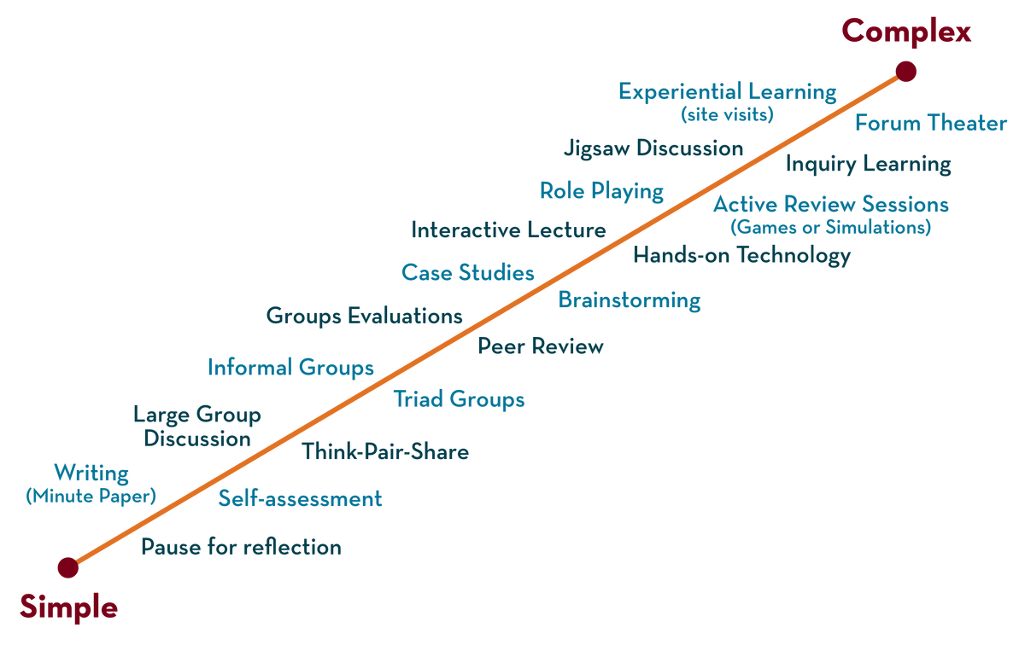
COURSE NAME : Operating Systems COURSE CODE: 21CS2109RA
Session - 3
CPU Scheduling, Multilevel Feedback,
Lottery Scheduling code, Multiprocessor Scheduling

Slide 2
AIM OF THE SESSION
To familiarize students with the concepts of CPU Scheduling, Multilevel Feedback, Lottery Scheduling code, Multiprocessor Scheduling.
INSTRUCTIONAL OBJECTIVES
This Session is designed to:
Problem Solving concepts of CPU Scheduling
Describe what is Multilevel Feedback
List out the Lottery Scheduling Procedures in operating systems
Describe the role of Multiprocessor Scheduling
A Case Study of Operating Systems: Different Types of CPU Scheduling Algorithms
LEARNING OUTCOMES
At the end of this session, you should be able to:
Defines CPU Scheduling, Multilevel Feedback, Lottery Scheduling code, Multiprocessor Scheduling.
Describe different CPU Scheduling Algorithms.
Summarize Role of Multi Processor Scheduling.

Slide 3
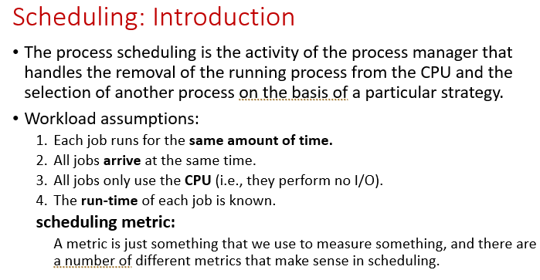

Slide 4
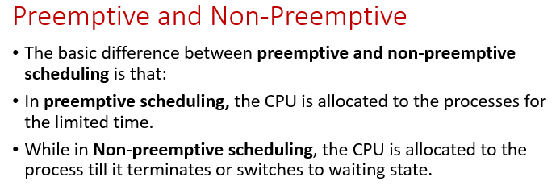

Slide 5
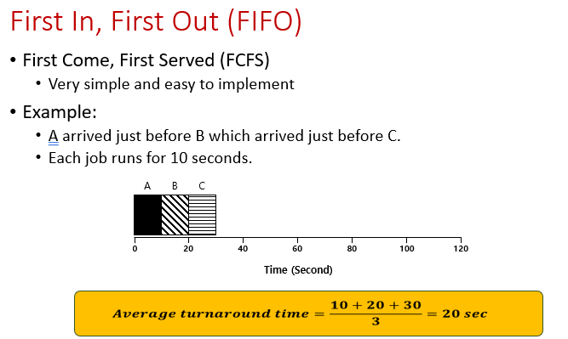

Slide 6
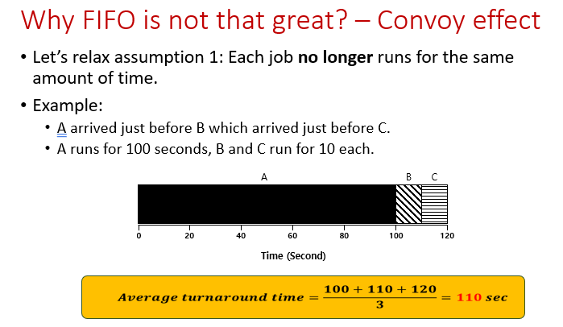

Slide 7
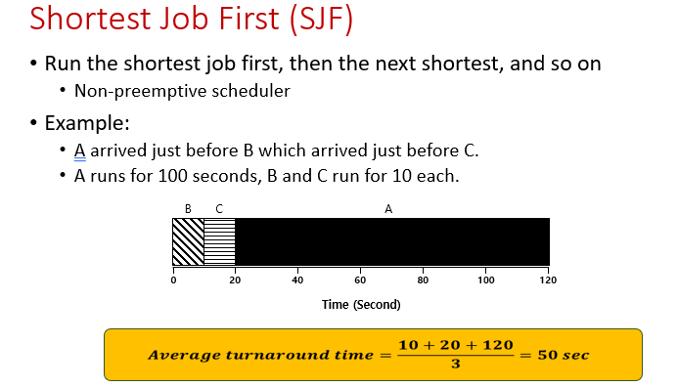

Slide 8
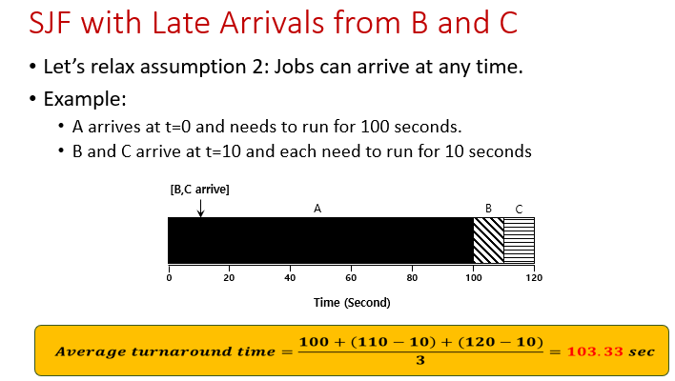

Slide 9
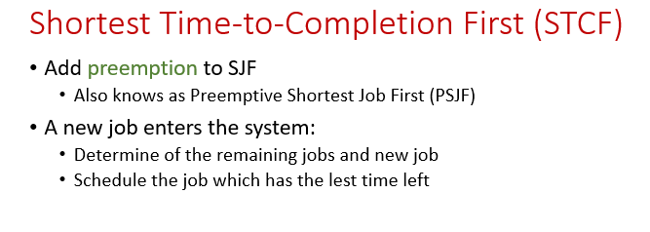

Slide 10
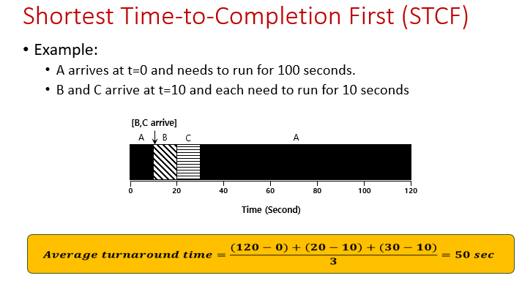

Slide 11
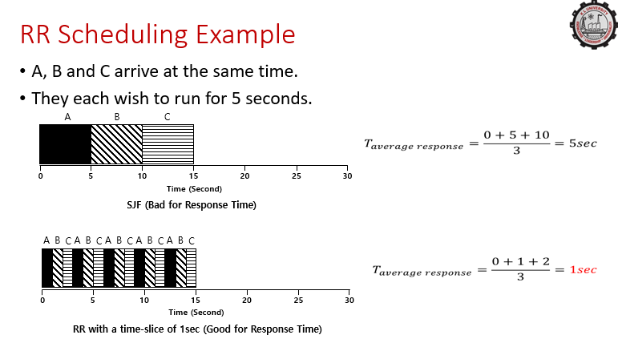

Slide 12
THE LENGTH OF THE TIME SLICE IS CRITICAL
The shorter it is, the better the performance of RR under the response time metric
However, making the time slice too short is problematic, suddenly the cost of context switching will dominate overall performance.
Thus, deciding on the length of the time slice presents a trade off to a system designer, making it long enough to amortize the cost of switching without making it so long that the system is no longer responsive

Slide 13
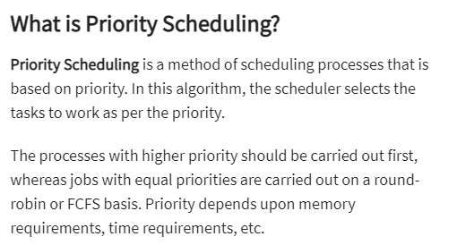

Slide 14
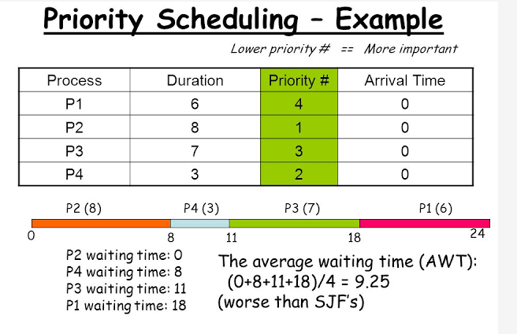

Slide 15
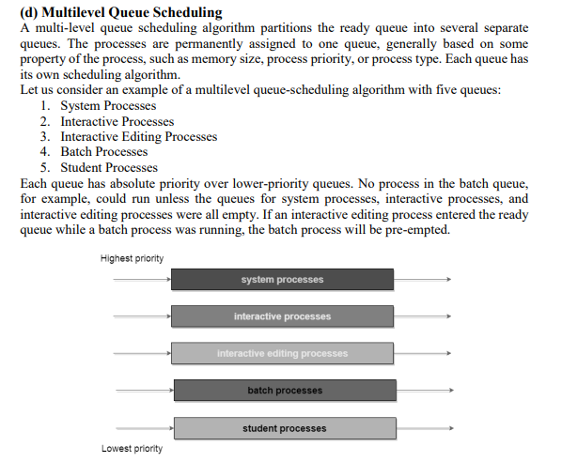

Slide 16
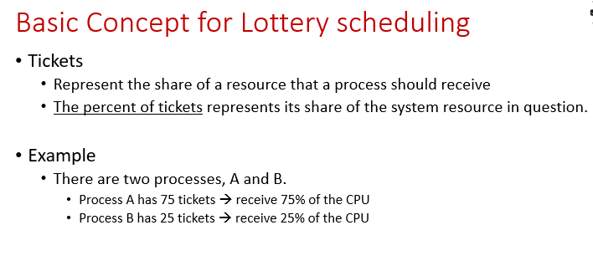

Slide 17
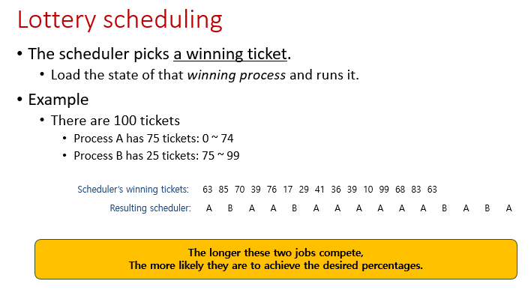

Slide 18
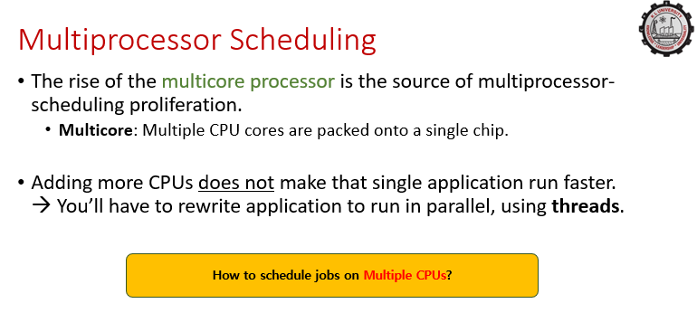

Slide 19
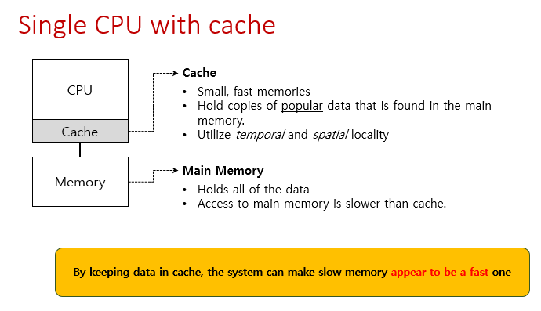

Slide 20
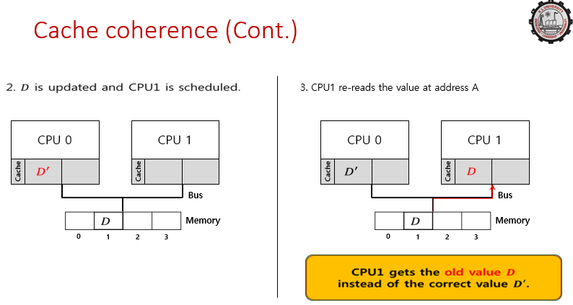

Slide 21
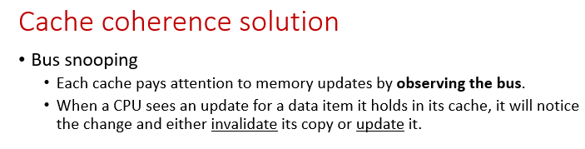

Slide 22
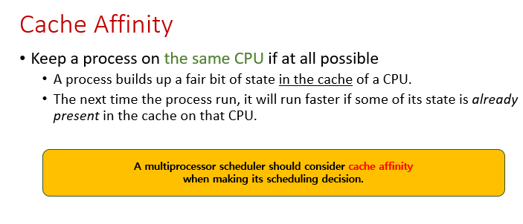

Slide 23
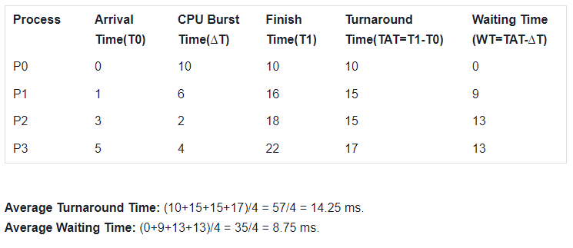
CPU SCHEDULING PROBLEMS AND SOLUTIONS
Consider 4 Processes, Calculate the Average Turn-around Time and Average Waiting Time using First Come First Serve using the Arrival Time 0, 1, 3, 5 and CPU Burst Time is 10, 6, 2, 4.

Slide 24
CPU SCHEDULING PROBLEMS AND SOLUTIONS
Consider 5 Processes, Calculate the Average Turn-around Time and Average Waiting Time using Shortest Job First Algorithm using the Arrival Time 3, 1, 4, 0, 2 and CPU Burst Time is 1, 4, 2, 6, 3.

Slide 25
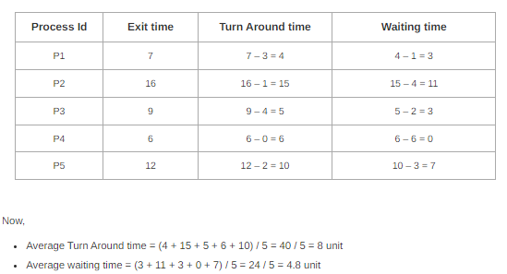
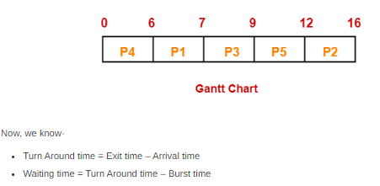

Slide 26
CPU SCHEDULING PROBLEMS AND SOLUTIONS
Calculate Average Waiting Time using the Shortest Job Remaining First (preemptive version of SJF scheduling), The Arrival Time is 0,1,2,3,4,5 and Burst Time is 8, 4, 2, 1, 3, 2

Slide 27
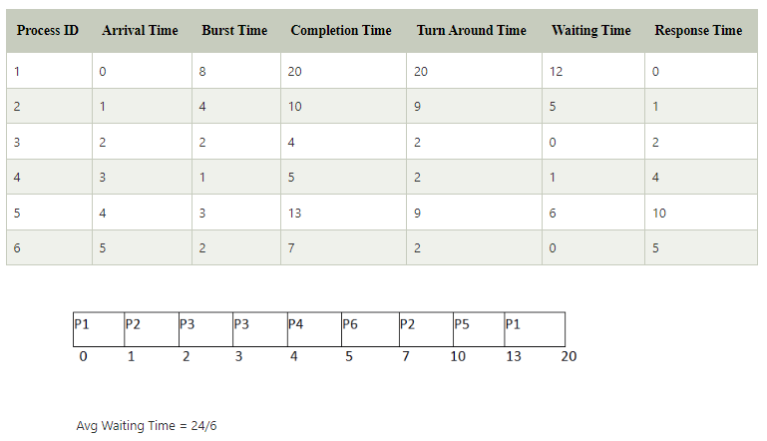

Slide 28
CPU SCHEDULING PROBLEMS AND SOLUTIONS
Consider six processes, Their arrival time 0,1,2,3,4,6 and burst time is 5, 6, 3, 1, 5, 4. The time quantum of the system is 4 units. Find the Average Waiting Time using Round Robin Scheduling Algorithm.

Slide 29
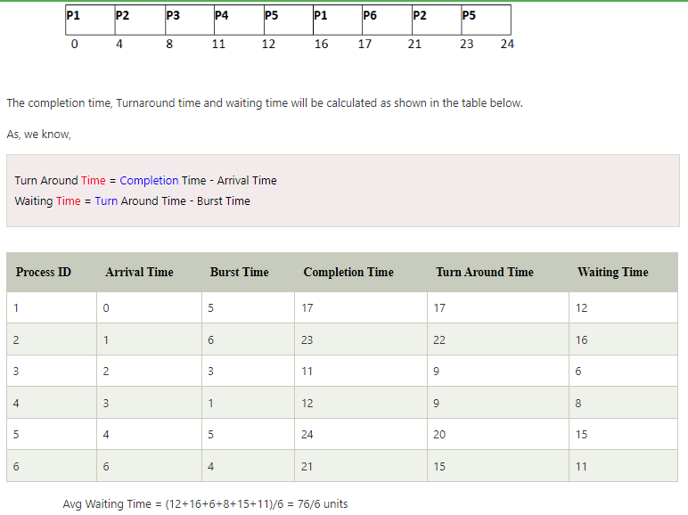

Slide 30
CPU SCHEDULING PROBLEMS AND SOLUTIONS
Consider Four processes, Their priority is 2,1,4,3and burst time is 21, 3, 6, 2. Find the Average Waiting Time using Priority Scheduling Algorithm.

Slide 31
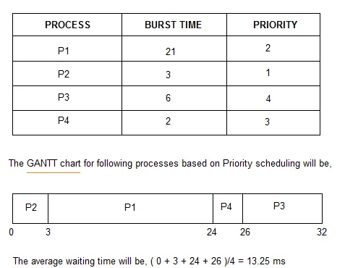

Slide 32
ACTIVITIES/ CASE STUDIES/ IMPORTANT FACTS RELATED TO THE SESSION
A Case Study of CPU Scheduling in Operating Systems.
A Comparative Study of CPU Scheduling in Case of FCFS and SJF
A Case Study of Primitive and Non-Primitive Algorithms

Slide 33
SUMMARY
First come first serve (FCFS) scheduling algorithm simply schedules the jobs according to their arrival time. The job which comes first in the ready queue will get the CPU first. The lesser the arrival time of the job, the sooner will the job get the CPU. FCFS scheduling may cause the problem of starvation if the burst time of the first process is the longest among all the jobs.
In SJF scheduling, the process with the lowest burst time, among the list of available processes in the ready queue, is going to be scheduled next.

Slide 34
SUMMARY
This Algorithm is the preemptive version of SJF scheduling. In SRTF, the execution of the process can be stopped after certain amount of time. At the arrival of every process, the short-term scheduler schedules the process with the least remaining burst time among the list of available processes and the running process.

Slide 35
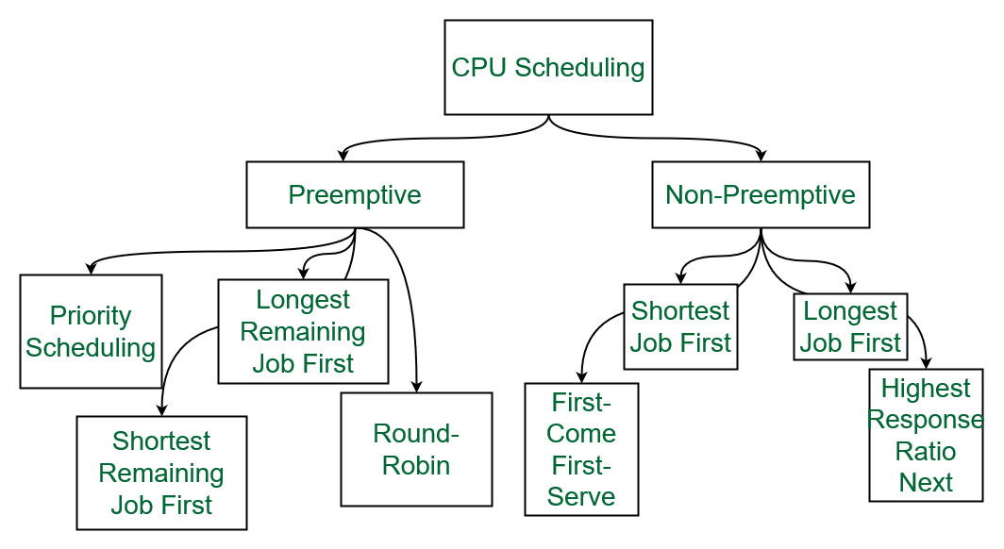

Slide 36
SELF-ASSESSMENT QUESTIONS
Which algorithm is defined in Time quantum?
shortest job scheduling algorithm
round robin scheduling algorithm
priority scheduling algorithm
multilevel queue scheduling algorithm
In multilevel feedback scheduling algorithm ____________
a process can move to a different classified ready queue AIX
classification of ready queue is permanent
processes are not classified into groups
none of the mentioned

Slide 37
TERMINAL QUESTIONS
Differentiate between preemptive and non-preemptive scheduling
List out the features of CPU Scheduling
Analyze role of different types of CPU Scheduling Algorithms in operating systems
Summarize what CPU Scheduling will do

Slide 38
REFERENCES FOR FURTHER LEARNING OF THE SESSION
Reference Books:
1. Arpaci-Dusseau, Remzi H., and Andrea C. Arpaci-Dusseau. Operating systems: Three easy pieces. Boston: Arpaci-Dusseau Books LLC, 2018. http://pages.cs.wisc.edu/~remzi/OSTEP/
Silberschatz, Abraham, Peter B. Galvin, and Greg Gagne. Operating system concepts. 10th edition, John Wiley & Sons, 2018.
Tanenbaum, Andrew. Modern operating systems. Pearson Education, Inc., 2009.

Slide 39
REFERENCES FOR FURTHER LEARNING OF THE SESSION
Sites and Web links:
https://www.cse.iitb.ac.in/~mythili/os/
https://cse.iitkgp.ac.in/~sumantra/courses/os/os_pg.html
https://www.cse.iitd.ernet.in/os-lectures

Slide 40

THANK YOU
Team – Operating System

